Slide 1
Project0 Presentation
By: Michael Buckner

Slide 2
Functionalities
Banking application with three levels of users
Customers
Deposit, withdraw, transfer, request an account/joint account, possess multiple accounts
Teller
View all customer accounts, deposit, withdraw, transfer from any account
Manager
All teller privileges + accept/deny account requests, delete accounts

Slide 3
Additional Functionalities
Registration
Customers can register for login account
Input validation
Input validation for all fields, unit of currency is gold coins (integer)
Password encryption

Slide 4
Project Design
Maven Project
Dependency manager
-Junit, logback, postgresql
3 Layer architecture organization
Controller
Contains menus to interface with user and allow input selection
Services
Contain business logic to manage transactions
DAO
Manages database connectivity

Slide 5
Additional Design Features
Contains Junit testing for methods in service layer
~75% service layer testing coverage
Logback to log user interactions with database
Logging for invalid inputs, overdraw attempts, and exiting program

Slide 6
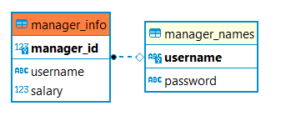
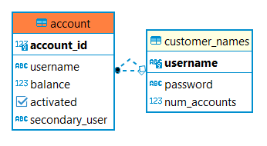
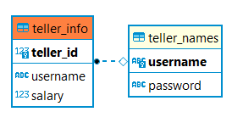
Database Structure

